Slide 1

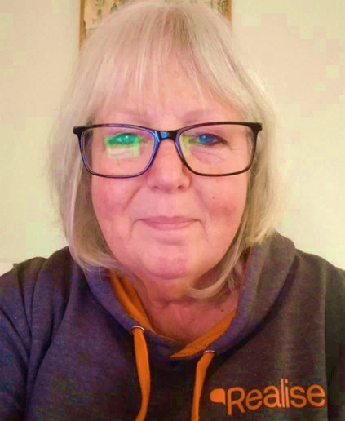
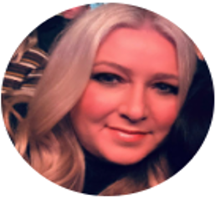
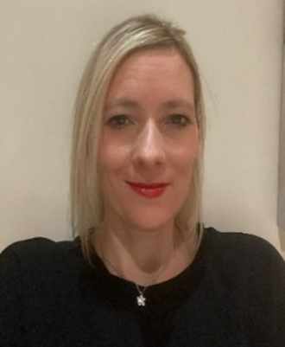
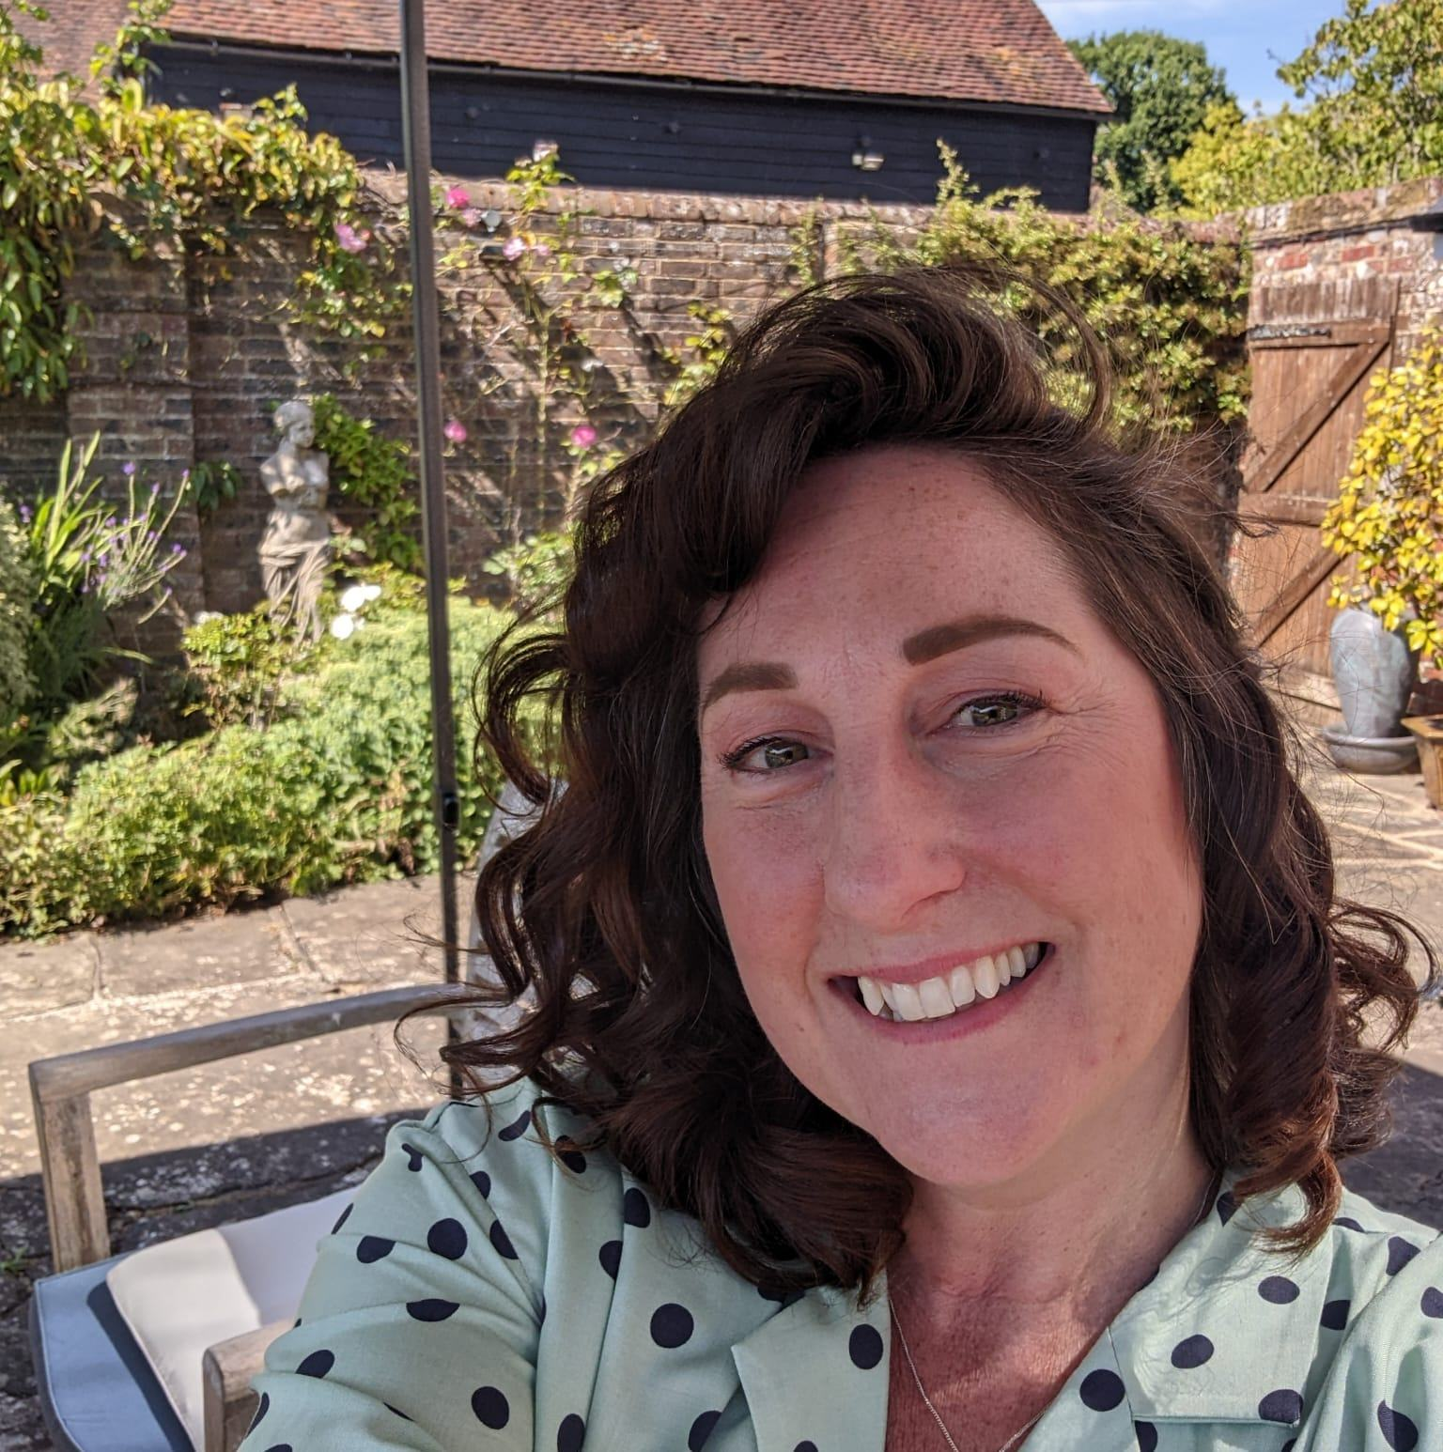
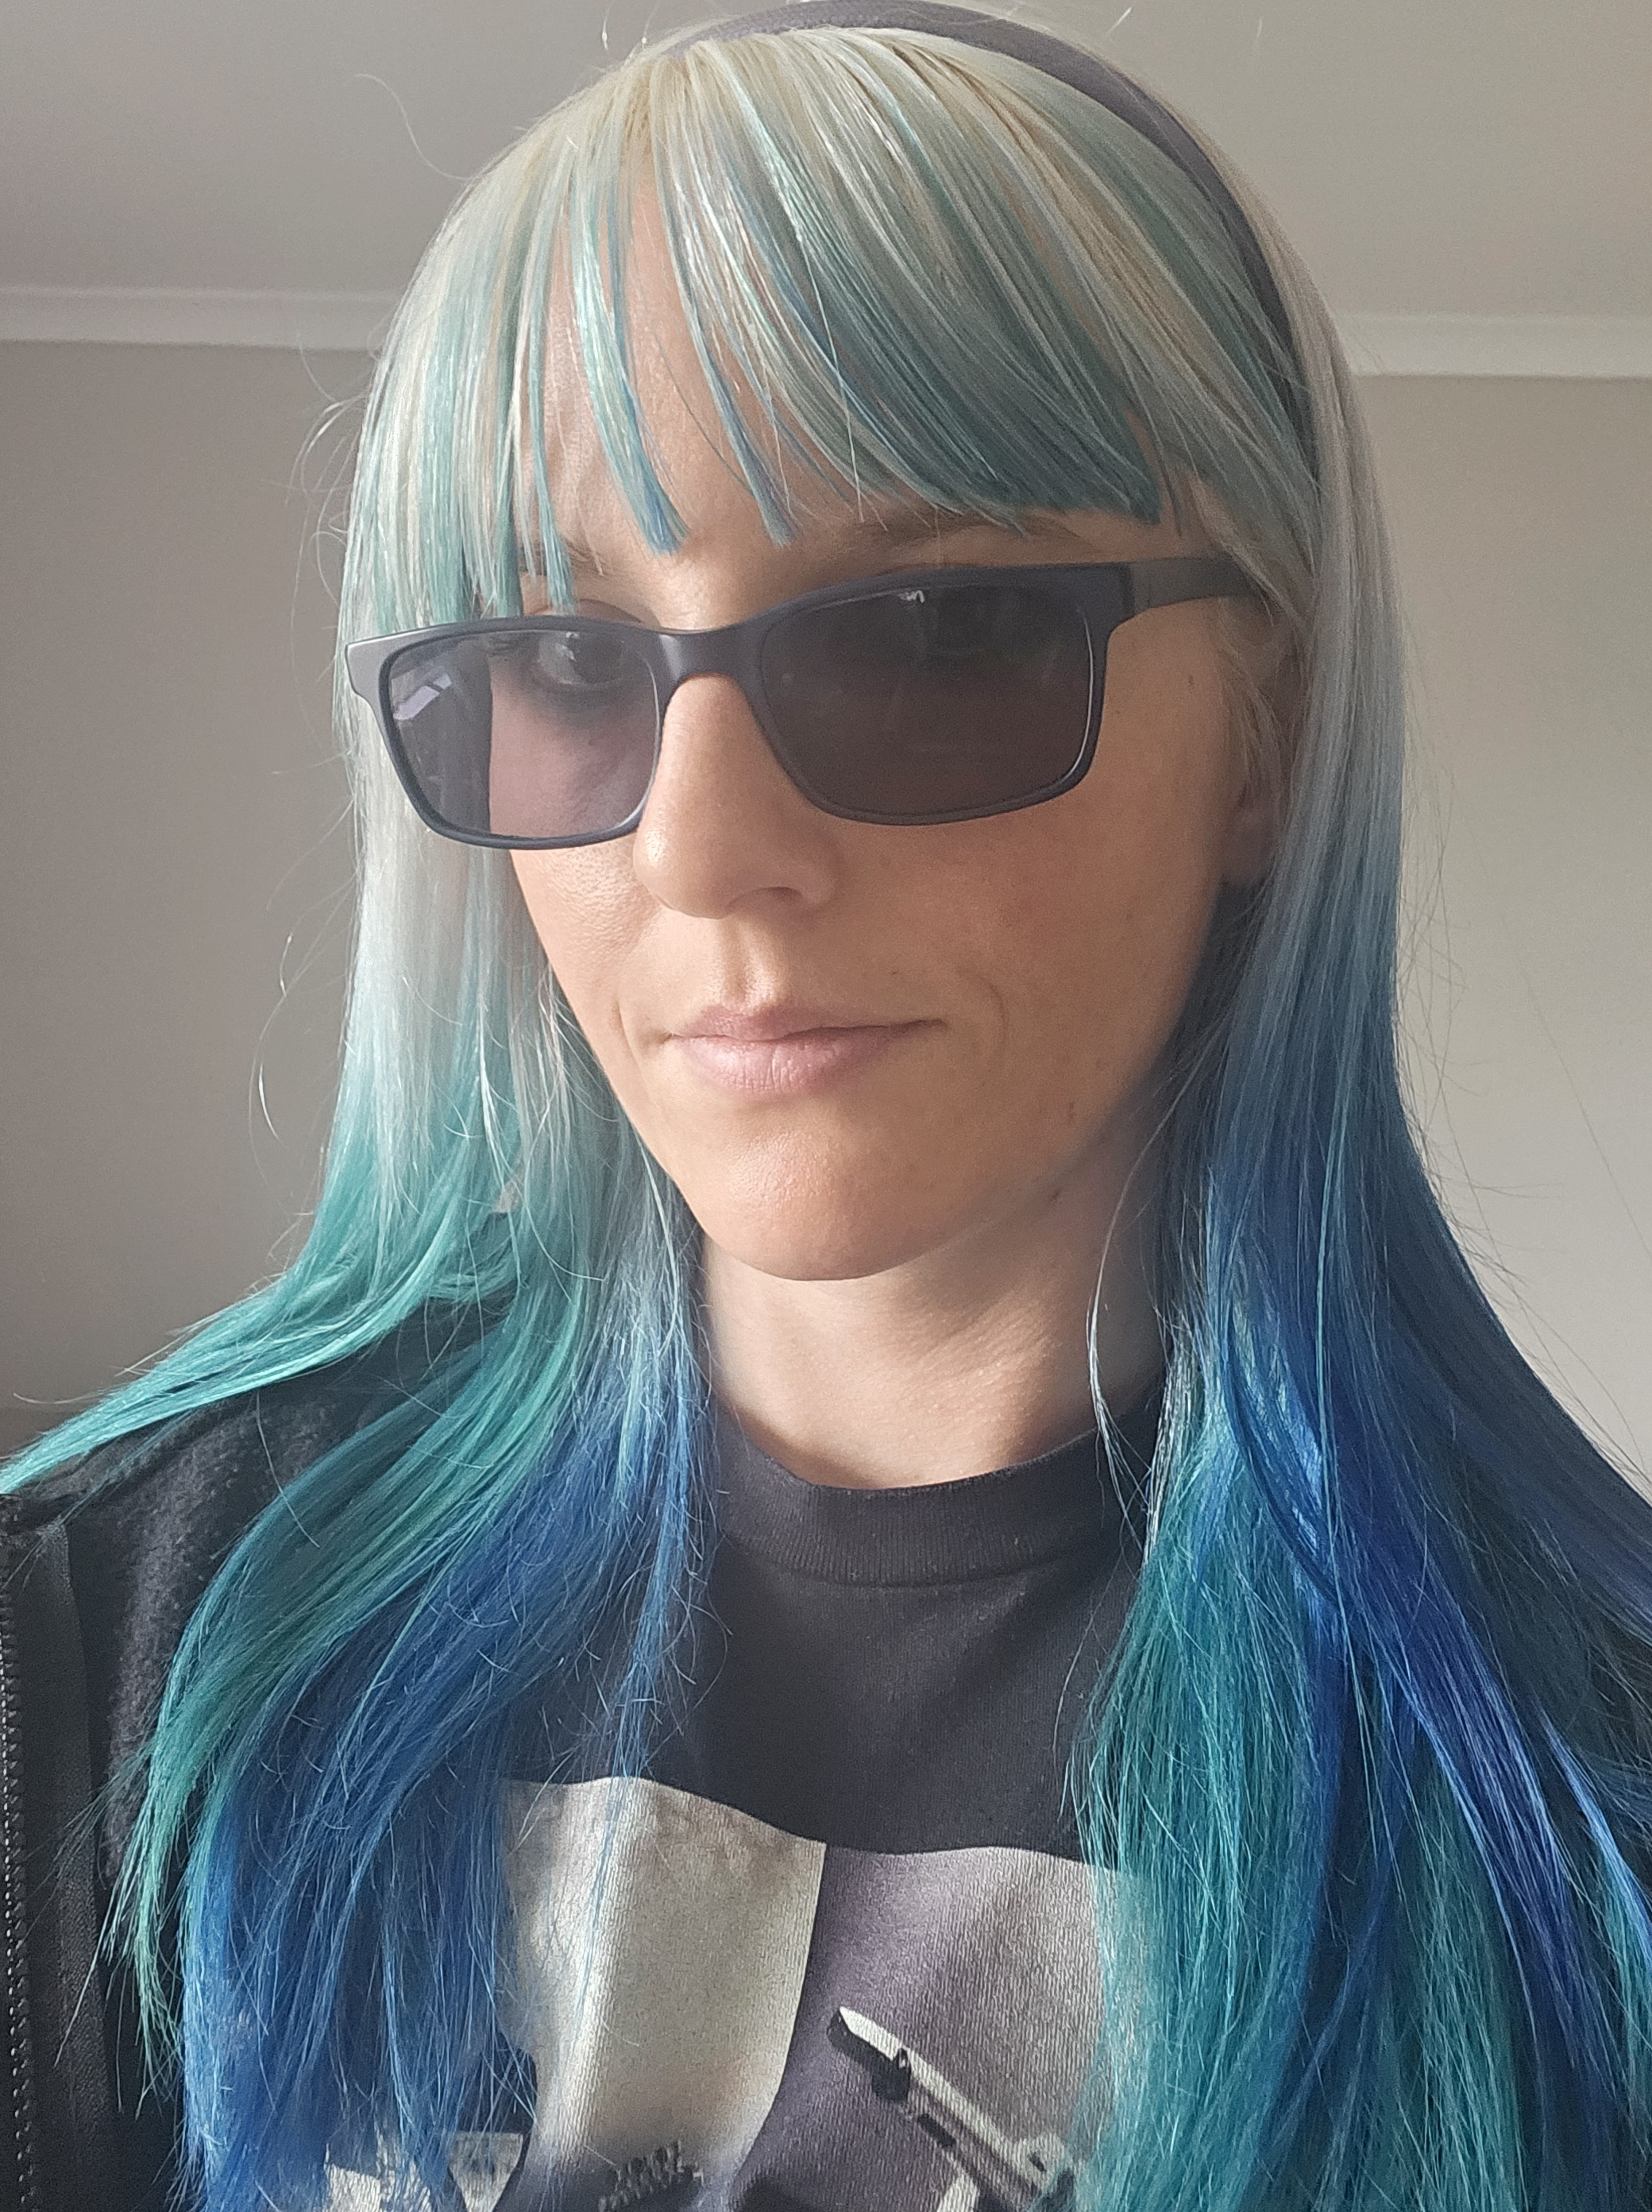
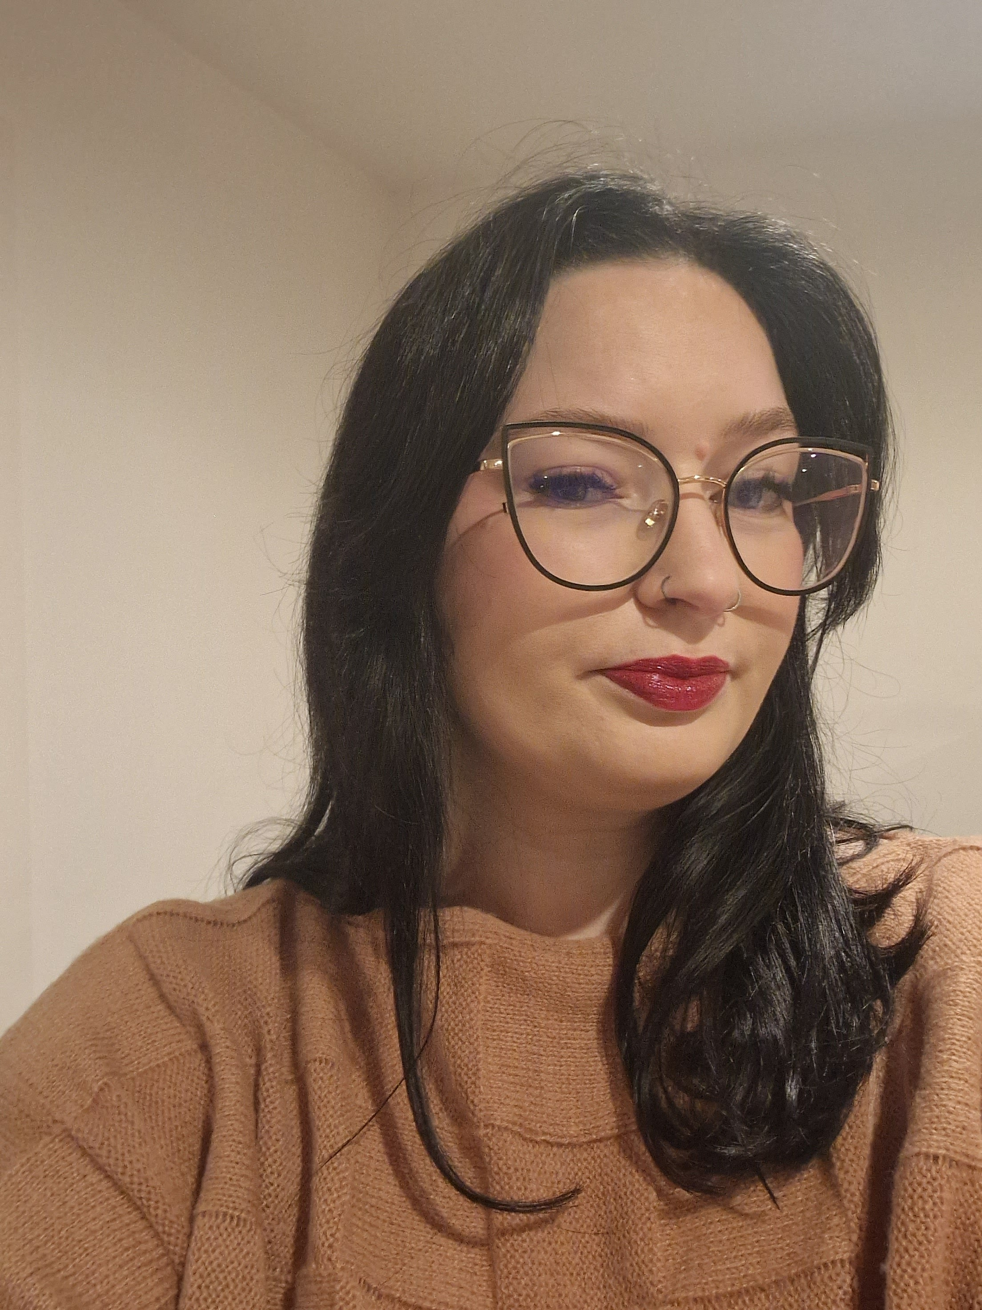
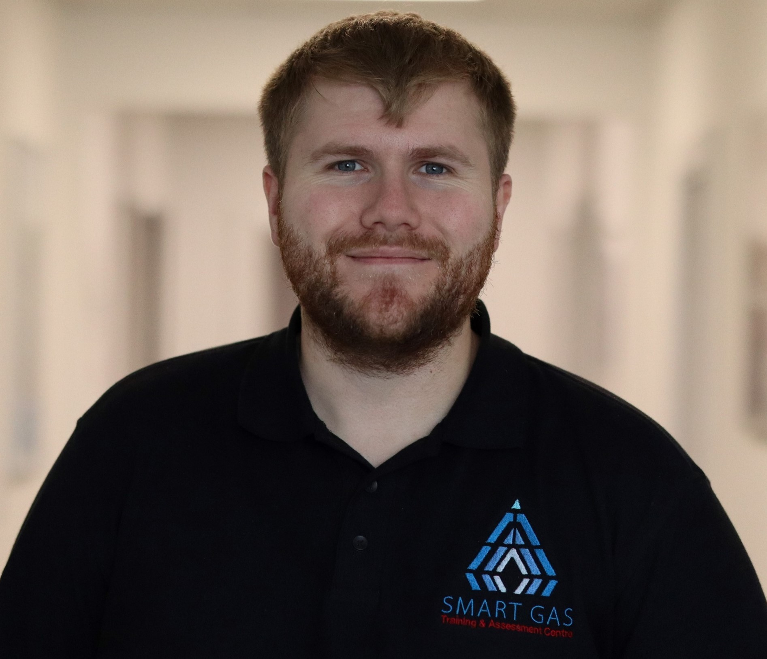
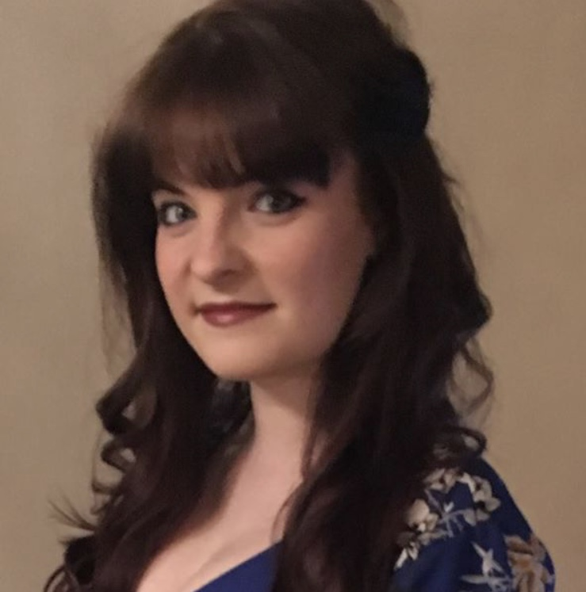
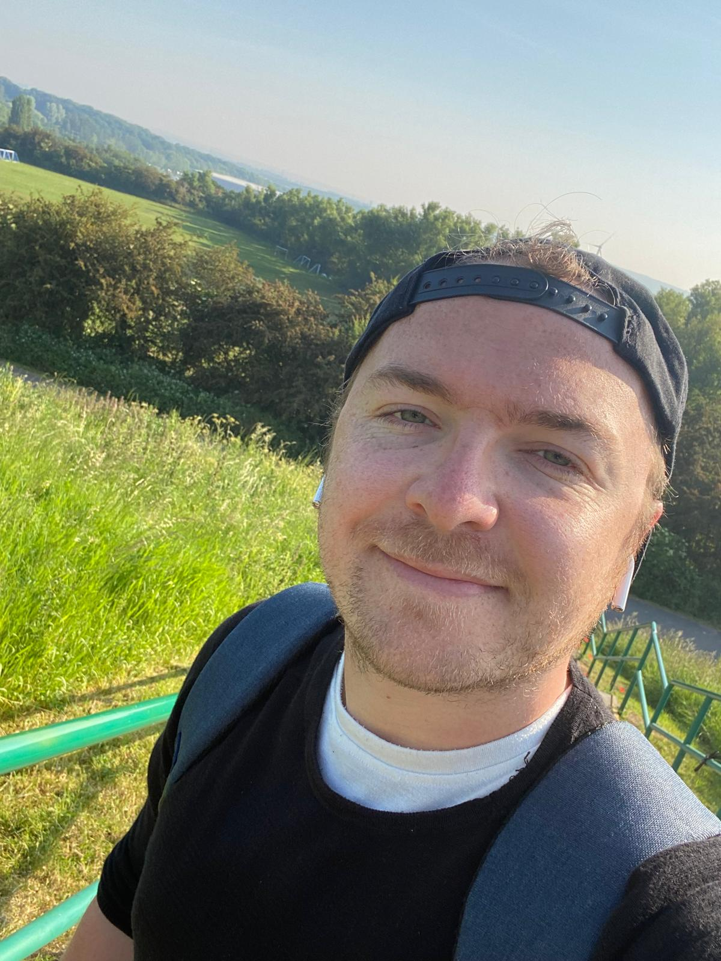
Safeguarding Team Structure
The whole team are trained as Designated Safeguarding Leads
and Mental Health First Aiders
Kim Curtain
Lesley Rimmington
Nola Beehl
Designated Safeguarding Lead
07763 618 163
Specialisms include:
Mental health, homelessness,
child protection, domestic abuse, suicide, self-harm, forced marriage, radicalisation.
Senior Leadership Lead
07841 075 197
Deputy Designated
Safeguarding Lead
07590 184 462
Specialisms include:
Mental health, family breakdowns, addictions, housing & benefits,
child protection
Nicola Balmforth
Rachel Lutz-Hall
Charlotte Gregory
Safeguarding Deputy
07841 199 172
Specialisms include:
Mental health, child protection,
pregnancy, miscarriage.
Safeguarding Deputy
07908 800 688
Specialisms include:
Neurodiversity, homelessness, domestic abuse, abuse, post natal depression, eating disorders bereavement and mental health.
Safeguarding Deputy
07940 446 486
Specialisms include:
Bereavement and supporting grieving families, LGBTQ+, men’s mental health issues, anxiety & depression and self harm.
Adam Kolaszynski
Emily-Jane Hennessy
James Chambers
Safeguarding Deputy
07889 302 934
Specialisms include:
Gambling addiction,
mental health.
Safeguarding Deputy
07908 801 078
Specialisms include:
Child protection concerns
in education settings,
domestic abuse
restraining orders
suicide, self-harm
Men’s Mental Health Champion
07702 275 023
Mental Health First Aider for Realise Employees

