Slide 1


We help people thrive.
Realise is a collection of 450 knowledgeable professionals who deliver inspiring and meaningful training programmes. Our people-centred culture helps us inspire over 7,000 learners a year.
Shaped by our behaviours
We pride ourselves on consistency and reliability. We believe that your chosen training provider should be one that you can rely on. We deliver on our promises and we’re always honest.

Slide 2


OFSTED rated Good
35+ Years of experience
We help people thrive.
Realise is a collection of 450 knowledgeable professionals who deliver inspiring and meaningful training programmes. Our people-centred culture helps us inspire over 7,000 learners a year.
We are
Shaped by our behaviours.
We pride ourselves on consistency and reliability. We believe that your chosen training provider should be one that you can rely on. We deliver on our promises and we’re always honest.
2022 Provider of the year
2nd Place on Rate My Apprenticeship

Slide 3
It’s a game changer.
We help people thrive.
OFSTED rated Good.
35+ Years of experience.
We are
2022 Provider of the year.
2nd Place on Rate My Apprenticeship.
It’s a game changer.
Shaped by our behaviours

Slide 4








Strategic Change
Small/Large Scale Construction
41% of Project Professionals have less than 5 years of experience.
The number of highly experienced Project Professionals in the industry is dropping.
Project Management?
Process & Policy Implementation
Logistics & Transport
Defence Initiatives
61% of organisations worry about a lack of skills to deliver projects successfully.
67% of organisations worry about being able to recruit the skills needed to deliver projects successfully.
It’s a game changer.
Performance Improvement
Technology & Digital Infrastructure
Training & Education Initiatives
85% of PM apprentices are satisfied within their roles, with 81% of Project Professionals also feeling satisfied in their job.
The average cost of projects in the UK is just under £100,000,000.

Slide 5
Unlock your potential.
Strategic Change
What do our Project Managers deliver?
Small/Large Scale Construction
Logistics & Transport
Process & Policy Implementation
Defence Initiatives
Technology & Digital Infrastructure
Performance Improvement
Training & Education Initiatives

Slide 6
Valuable & Tailored Support,
We Support Organisations.
Providing insight into how they can best support apprentices.
Working closely with mentors, coaches & managers to identify development needs.
Sharing course requirements, how they can be achieved and pro-actively plan this with both you and your apprentices.
Providing regular updates on your apprentice's progress.
We Support Apprentices.
Tailoring your journey in line with the work you’re doing – putting learning into context.
1:1 support throughout the course, with engaging workshops.
Access to delivery materials, workshops, revision sessions and study guides.
Guidance from PM specialists and APM student membership.
Unlock your potential.

Slide 7
What can you expect?
12 Key Modules
Project Context
Project Governance
Stakeholder & Communication Management
Business Case & Benefits Management
Scope Management
Risk & Issue Management
Schedule Management
Resource Management
Consolidated Planning
Budgets & Cost Control
Contract Management & Procurement
Quality Management

Slide 8
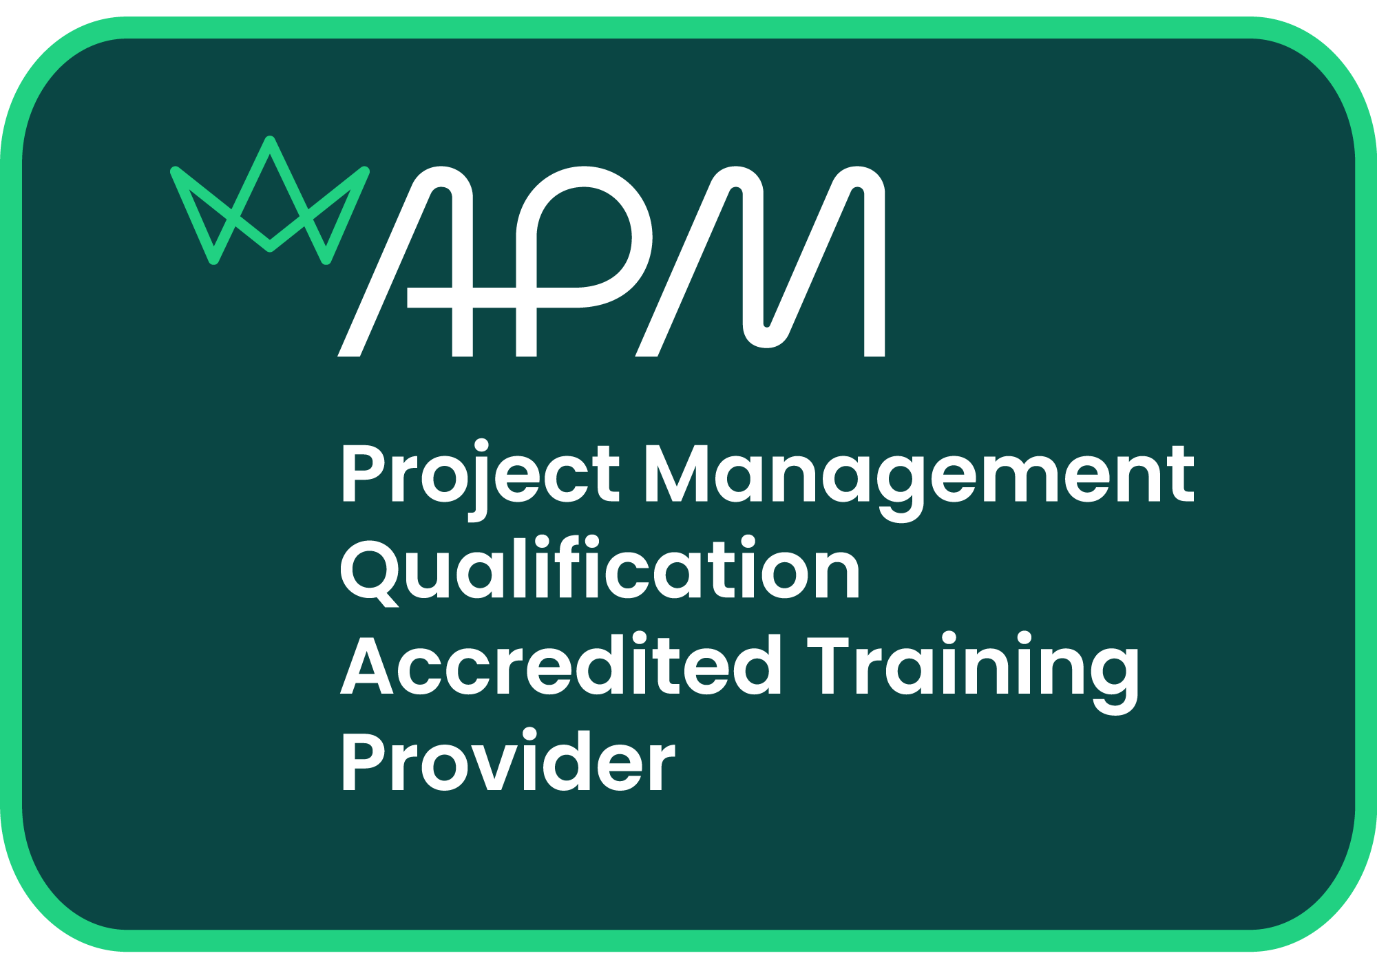
What can you expect?
Project Context
Project Governance
Stakeholder & Communication Management
Business Case & Benefits Management
The project environment & analysis tools, PESTLE, SWOT & VUCA.
Project Life Cycles, phases, control & management of projects.
Communication plans, stakeholder mapping & negotiation techniques.
Business case through the project life cycle & benefits management.
Scope Management
Risk & Issue Management
Schedule Management
Resource Management
Requirements, baseline & change management.
Risk & Issue planning, mitigation & impact on project delivery.
Scheduling techniques, such as GANTT & estimation tools.
Resource requirements, analysis, allocation & acceptance.
Consolidated Planning
Budgets & Cost Control
Contract Management & Procurement
Quality Management
Purpose of project management plans & configuration control.
Direct & In-direct costs, budget approval and cost management.
Contracts, their implications and procurement processes.
Quality management planning, purpose & continuous improvement.

Slide 9
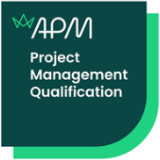


Lucrative Career Routes
You’re in safe hands. Realise are an accredited training provider for the Project Management Qualification.
What can you expect?
Access to free student membership with the Association for Project Management.
Access to the APM PMQ Study Guide from day 1 on programme. (Worth £35)
Materials that have been vetted by the APM as part of the accreditation process.
95% of people surveyed believe that taking an APM qualification will add value to their career – APM qualifications survey.
95%

Slide 10

Don’t take our word for it…
80% of those surveyed in the 2023 Market trends survey said they felt optimistic about supply of project management jobs in the next 5 years.
Lucrative Career Routes.
65% reported an increase in pay and benefits packages.
52% stated training & development was important to them.
59% of organisations are growing & looking to recruit.
Specialist Roles for those with a keen interest:
Risk & Issue Specialists
Quality & Compliance Specialists
Procurement & Contract Specialists
Continued Learning for Senior professionals:
Ops Management Level 5
Project Manager Level 6
Data Analyst Level 4
Specialisms & training.
Top tips for orgs. & apprentices Interested:
Transferable Skills Across Management
Strategic & Operational Management
Senior Project roles, Portfolio & Programme management

Slide 11
Don’t take our word for it…
Lucrative Career Routes.
There’s two main routes to secure the funding required for an apprenticeship programme.
Funding for apprenticeships.
The Apprenticeship Levy
If you’re an employer with a £3million wage bill or more, then you’re able to utilise your levy pot for apprenticeship funding.
Non-Levy Apprenticeships
For employers who don’t yet have as high a wage bill, you won’t be able to utilise your levy, however:
95% of the apprenticeship funding will be provided by the ESFA.
There’s only a 5% contribution upon your apprentice starting their programme.
The Associate Project Manager Level 4 Programme is £6000
This is split throughout the apprenticeship programme.
Top tips for orgs. & apprentices Interested:
18 On Programme Payments throughout programme split monthly.
20% Paid on entrance into Gateway.

Slide 12
Don’t take our word for it…
Alex Rowe, the lead sponsor for PMO at Transport for London had this to say about our programme.
Don’t take our word for it…
“Working with Realise has been a very positive experience. They are willing to work with employers to resolve issues, listen to feedback and make the apprentice experience the best it can be”
Helen’s top tips
“They are very knowledgeable and ensure that all aspects are communicated to apprentices and employers. We have had several cohorts move into Assistant Project Manager roles, as well as some promoted into Project Managers!”
“At TfL we have found the Project Management Apprentices a real asset to the organisation. Communication is key with Realise & apprentices to ensure progress is made and the support levels are suitable. Having a pipeline of new talent through the Apprenticeship scheme reduces reliance on temporary workers and develops internal talent for the Apprentices to have a long Project Management career in TfL”
Top tips for orgs. & apprentices Interested:

Slide 13

Don’t take our word for it…
Helen, an APM apprentice with the Ministry of Defence shared her thoughts on her experience
Don’t take our word for it…
“I started my apprenticeship when I was in a Project Support role, and it has given me the knowledge & skills to progress and gain promotion. I am now managing a portfolio of varied infrastructure projects. I have found the more I learn, the more I want to learn!”
Helen’s top tips
“I have had a complete career change after working as a front-line prison officer, I’m now managing the delivery of infrastructure projects within military sites! This work is interesting and I’m learning something new every day. I will admit, the apprenticeship course was daunting at first, however my confidence in my abilities has grown and grown as I have realised what I am capable of. There have been skills and knowledge I’ve learned in my studies I’ve been able to share with my colleagues, helping us improve as a team!”
Go for it! It’s a competitive world out there, this is an opportunity to embark on a new career whilst earning a salary. It’s a no brainer to be honest!
Employers – taking on an apprentice gives you the opportunity to build an enthusiastic, dedicated workforce!
Research and ask lots of questions! You might discover a different path you hadn’t considered before!
Top tips for orgs. & apprentices Interested:

Slide 14
Want more information?
Click here for more from Realise
Click here for more about the Standard
What are you waiting for?
We offer both closed & open cohorts depending
on scale.
Talk to us to find out more information on how we
can support the development of your colleagues.
We can tailor to your organisation
Interested in joining an apprenticeship?
Our next open cohort is scheduled to start on the 29th November.
What do you need to get started?
We only need emails and contact numbers to start the enrolment process.
Talk to us if you want to know more!
Email us using hello@realisetraining.com and we will support you.

